Slide 1
DAA-005 Web Scraping
A quick crash course into the fundamentals of web scraping with python
SIM Data Analytics Club

Slide 2
What is Web Scraping?
Definition
Automated methods of extracting data from websites.
Involves sending requests, parsing HTML, and extracting specific information
SIM Data Analytics Club

Slide 3
What is Web Scraping?
How it Works in General:
Send a request to a webpage
Parse its structure (HTML/CSS)
Extract the needed information
Key Idea:
Converts unstructured web data into structured formats (CSV, JSON, Excel)
SIM Data Analytics Club
Notes:
How It Works (High-Level Steps)
Sending Requests:
The program sends an HTTP request to the website server.
The server responds with HTML content (the webpage).
Parsing HTML:
The received HTML is parsed to understand its structure.
Tools like BeautifulSoup or lxml help navigate the HTML tree.
Extracting Specific Information:
Identify the HTML elements containing the desired data.
Extract values such as text, links, tables, images, etc.

Slide 4
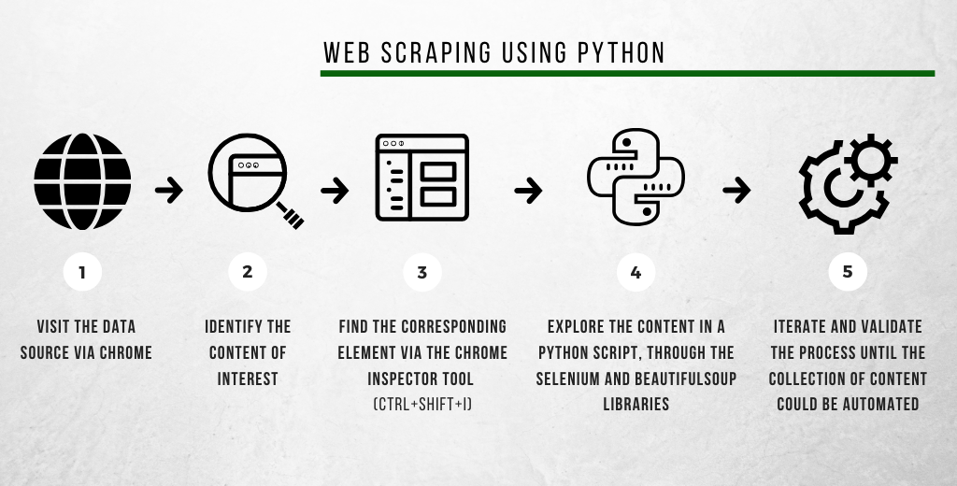
What is Web Scraping?
SIM Data Analytics Club
Notes:
Use BeautifulSoup when the website content is static and you just want to extract data quickly.
Use Selenium when the site has dynamic content that requires user interaction or JavaScript rendering

Slide 5
Why Web Scraping?
Fills Data Gaps
Cost-Effective
Flexible
When APIs/structured datasets are unavailable for processing
Extracts valuable insights without proprietary tools
Customizable for any public website
SIM Data Analytics Club
Notes:
Web scraping is widely used because it allows us to gather large amounts of data efficiently.
It addresses key challenges in data collection and analysis."
1️⃣ Fill Data Gaps
Many datasets are incomplete or not publicly available in structured form.
Web scraping allows us to collect missing data from websites.
Example: Collecting product prices, news articles, or weather information to enrich datasets.
2️⃣ Cost-Effective
Avoids manual data collection, which is time-consuming and expensive.
Automates repetitive tasks, saving human resources.
No need to pay for commercial datasets if data is publicly available.
3️⃣ Flexible
Works on a wide variety of websites and formats.
Can be customized to target specific data points (tables, images, links, text).
Supports different programming tools and workflows: Python, Selenium, BeautifulSoup, APIs.

Slide 6
Practical use cases of Web Scraping in the Workforce
Monitoring E-Commerce Prices
Analyzing Public Sentiment from Social Media
Gather open data for machine learning
SIM Data Analytics Club
Notes:
Web scraping is not just a theoretical tool—it’s widely used across industries to collect, analyze, and act on data."
1️⃣ Monitoring E-Commerce Prices
Businesses track competitor prices in real-time.
Helps in dynamic pricing strategies or spotting market trends.
Example: Online retailers like Amazon or Flipkart adjusting prices based on competitor data.
2️⃣ Analyzing Public Sentiment from Social Media
Scrape tweets, posts, or comments to measure public opinion.
Useful for marketing campaigns, brand management, or political analysis.
Example: Understanding customer reaction to a new product launch.
3️⃣ Gathering Open Data for Machine Learning
Collect large amounts of structured or semi-structured data for AI projects.
Can build datasets for training models like NLP sentiment analysis or recommendation systems.
Example: Scraping weather reports or financial news for predictive modeling.

Slide 7
Where does Web Scraping belong in Data Science?

Slide 8
Where does Web Scraping belong?
Advanced Techniques | Deep Learning, Large Language Models (LLMs)
Machine Learning | Traditional ML, Model Evaluation
Statistical Analysis | Hypothesis Testing, Feature Engineering
Exploratory Data Analysis | Visualisation, Descriptive Satistics
Data Cleaning, Preprocessing | Data Wrangling, Normalisation & Scaling
Data Storage, Management | Data Lakes, Data Warehouses, ETL/ELT Pipelines
Data Collection | Web Scraping, APIs, Sensors/Logs
SIM Data Analytics Club
Notes:
Data Collection Layer
Web scraping belongs to the Data Collection stage.
Other methods in this stage include:
APIs
Sensors / Logs
Public datasets
Its role is to gather unstructured or semi-structured data for further processing.
Web scraping comes first: without data, none of the subsequent steps are possible.
3️⃣ Why It Matters
Quality of analysis depends on quality of data.
Automated collection ensures timely and large-scale data.
Enables building robust ML models, dashboards, and insights.
💡 Key Points
Think of web scraping as the entry point into the data science pipeline.
It is complementary to APIs and other collection methods.
Preprocessed and structured scraped data flows into storage, cleaning, and analysis stages.
💡 Summary (Wrap-up for the slide)
*"In short:
Web scraping is part of Data Collection,
Provides the raw material for all downstream tasks,
Forms the foundation for exploratory analysis, ML modeling, and advanced AI applications."*

Slide 9
Use case with External Projects: FDM Singapore
Landing Page and Online Sentiment Analysis
  Campaign landing page
  Reddit (API)
HR firm Competitor Analysis
  Batch scraping from competing websites (Glassdoor, GradConnect, Indeed.com)
28.11.24
SIM Data Analytics Club
Notes:
"Web scraping is widely applied in real-world projects to gather actionable insights.
Here are some concrete examples from external projects."
1️⃣ FDM Singapore Campaign Landing Page
Scraping content from company landing pages to analyze:
Promotions or marketing campaigns
Course offerings or internship info
Helps in competitor benchmarking and campaign analysis
2️⃣ Online Sentiment Analysis via Reddit
Using Reddit API or web scraping to gather posts and comments:
Measure public sentiment about products, companies, or events
Extract text data for sentiment scoring and trend analysis
Useful for marketing insights and brand perception monitoring
3️⃣ HR Firm Competitor Analysis
Batch scraping from websites like:
Glassdoor, GradConnect, Indeed.com
Extract job postings, company reviews, salaries
Enables HR firms to:
Analyze competitor hiring trends
Identify employee sentiment and satisfaction
Inform talent acquisition strategies
💡 Key Points for Students
Web scraping turns publicly available data into actionable intelligence.
Supports data-driven decision making in marketing, HR, and research.
Projects may use a combination of APIs and scraping depending on accessibility.

Slide 10

Introduction to BeautifulSoup

Slide 11
Introduction to BeautifulSoup
What is BeautifulSoup?
A Python library for parsing HTML and XML
Works well for static websites
Features
Easy-to-use methods like .find() and .find_all()
Handles messy HTML structures
SIM Data Analytics Club
Notes:
Introduction
"BeautifulSoup is a Python library widely used in web scraping to extract information from HTML and XML documents."
1️⃣ Definition
BeautifulSoup: A Python library for parsing HTML and XML.
Ideal for scraping static websites (pages where content doesn’t rely on JavaScript).
2️⃣ Key Features
Easy-to-use methods:
.find() → finds the first matching tag
.find_all() → finds all matching tags
Handles messy HTML:
Can parse web pages even if the HTML is imperfect or poorly formatted
Works seamlessly with requests to fetch web pages.
3️⃣ Why It’s Useful
Allows rapid extraction of text, links, tables, images, and attributes.
Lightweight and faster than automating browsers for static content.
Forms a core tool in many web scraping pipelines.
💡 Key Points for Students
BeautifulSoup is best for static HTML where content is directly available.
Can be combined with requests or urllib to fetch pages.
Not suitable for dynamic, JavaScript-rendered content (for that, Selenium is better).

Slide 12
Introduction to BeautifulSoup
Workflow
Fetch the webpage using requests
Parse HTML using BeautifulSoup
Locate and extract desired elements (e.g. titles, links, tables)
SIM Data Analytics Club
Notes:
Introduction
"Web scraping with BeautifulSoup follows a simple, structured workflow that transforms raw web content into usable data."
1️⃣ Fetch the Webpage
Use the requests library to send an HTTP GET request to the URL.
Example:
import requests
page = requests.get('https://example.com')
The response contains the raw HTML of the page.
2️⃣ Parse HTML Using BeautifulSoup
Initialize BeautifulSoup with the HTML content.
Example:
from bs4 import BeautifulSoup
soup = BeautifulSoup(page.content, 'html.parser')
Converts the raw HTML into a navigable tree structure.
3️⃣ Locate and Extract Desired Elements
Identify elements using tags, classes, or IDs.
Example:
titles = soup.find_all('h2')
links = soup.find_all('a')
Extract text or attributes from elements:
for title in titles:
print(title.get_text())
Works for tables, lists, images, and other HTML elements.
💡 Why This Workflow Matters
Provides a repeatable process for scraping websites.
Ensures clean and structured data for analysis.
Forms the foundation for more advanced scraping pipelines.
💡 Summary (Wrap-up for the slide)
*"In short, the BeautifulSoup workflow is:
Fetch webpage → 2. Parse HTML → 3. Locate & extract data.
This simple sequence turns raw HTML into actionable data efficiently."*

Slide 13
Let’s code!

Slide 14
Advanced Web Scraping Techniques
Scrapy
Best for large-scale, automated crawling
Efficient pipelines for handling and storing data
Selenium
For interacting with dynamic, JavaScript-heavy sites
Simulates user actions like clicking or logging in
SIM Data Analytics Club
Notes:
"While BeautifulSoup is great for small, static pages, some projects require large-scale scraping or dynamic interactions.
For these scenarios, we use Scrapy or Selenium."
1️⃣ Scrapy
Purpose: Best for large-scale, automated crawling.
Features:
Handles multiple pages efficiently using crawlers.
Built-in pipelines for storing data into CSV, JSON, or databases.
Supports scheduling, retries, and concurrency for high-performance scraping.
Use Case: Collecting thousands of product listings from e-commerce websites.
2️⃣ Selenium
Purpose: For dynamic, JavaScript-heavy websites.
Features:
Opens a real browser and simulates user actions: clicking, scrolling, logging in.
Extracts data that is not immediately available in static HTML.
Use Case: Scraping content behind login forms or interactive dashboards.

Slide 15
Why use other methods over BeautifulSoup?
Decision-Making Factors
Is the website static or dynamic?
How large is the data?
Is scalability important
Scenarios
Scrape a single static page > BeautifulSoup
Crawl an entire e-commerce site > Scrapy
Scrape dynamic pages with interactions > Selenium
SIM Data Analytics Club
Notes:
Introduction
"BeautifulSoup is great for simple tasks, but the choice of a scraping tool depends on website type, data volume, and scalability requirements."
1️⃣ Decision-Making Factors
Is the website static or dynamic?
Static → content is directly in HTML → BeautifulSoup works.
Dynamic → content loads via JavaScript → Selenium or Scrapy needed.
How large is the data?
Small dataset → BeautifulSoup is sufficient.
Large-scale datasets → Scrapy is more efficient.
Is scalability important?
For one-off scrapes → BeautifulSoup or Selenium.
For repeated, automated crawls → Scrapy.
Why Use Other Methods?
Selenium → Needed for interacting with dynamic content.
Scrapy → Needed for large-scale, automated scraping.
BeautifulSoup is simple and fast, but may fail for dynamic or high-volume sites.

Slide 16
Web Scraping Ethics
Do’s
Follow robots.txt
Limit request rates to avoid overloading servers
Use scraped data responsibly
Don’ts
Scrape sensitive or private data
Bypass security measures (CAPTCHA)
SIM Data Analytics Club
Notes:
Introduction
"Web scraping can provide huge benefits, but it must be done ethically and responsibly.
Violating website rules or privacy can have legal consequences."
1️⃣ Do’s
Follow robots.txt
Check the website’s robots.txt file to see which pages are allowed for scraping.
Example: https://example.com/robots.txt
Limit request rates
Avoid sending too many requests in a short time to prevent server overload.
Use delays between requests (time.sleep()) and polite scraping practices.
Use scraped data responsibly
Ensure the data is used for research, analysis, or other lawful purposes.
Give proper attribution if required.
2️⃣ Don’ts
Scrape sensitive or private data
Avoid personal information, login credentials, or confidential content.
Bypass security measures
Don’t circumvent CAPTCHAs, paywalls, or other protections.
Doing so may be illegal and unethical.
💡 Key Points for Students
Ethical scraping ensures legal compliance and respect for website owners.
Following best practices makes scraping sustainable and reliable.
💡 Summary
"In short:
✅ Follow robots.txt, limit requests, use data responsibly
❌ Don’t scrape sensitive/private data, don’t bypass security
Ethical scraping protects you, your data, and the integrity of your projects."

Slide 17
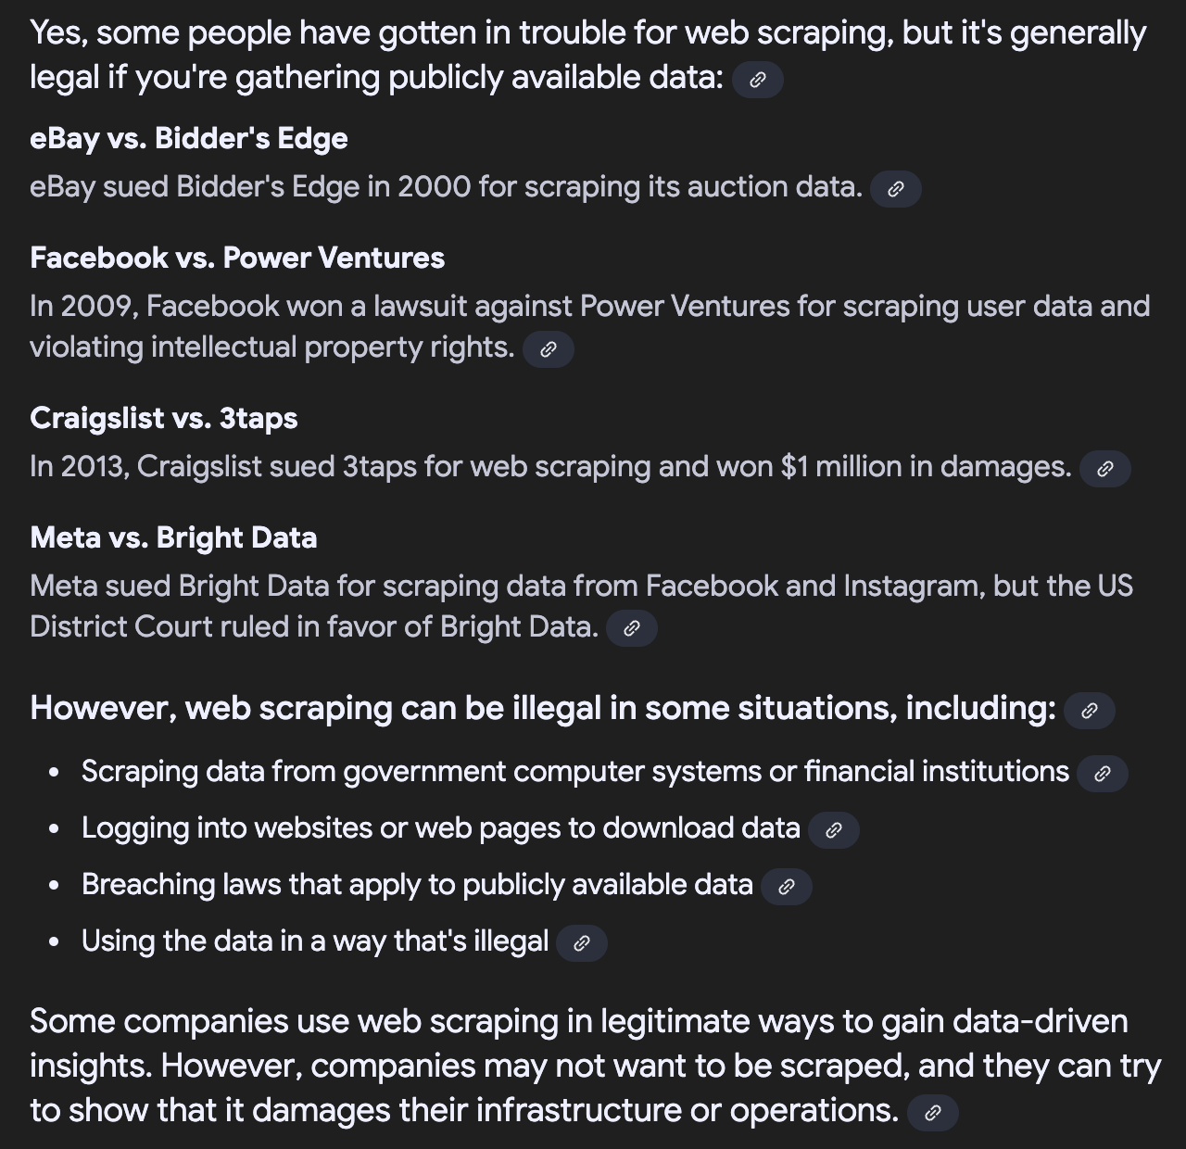
Web Scraping Ethics
SIM Data Analytics Club

